Slide 1


Solving the Business Problem: Predict the price of the Car with the multiple independent variables
Dhruv Thakran
Data Science Aspirant✨

Slide 2
Problem Statement :
There is an automobile company XYZ from Japan which aspires to enter the US market by setting up their manufacturing unit there and producing cars locally to give competition to their US and European counterparts.
They want to understand the factors affecting the pricing of cars in the American market, since those may be very different from the Japanese market. Essentially, the company wants to know:
Which variables are significant in predicting the price of a car
How well those variables describe the price of a car
Based on various market surveys, the consulting firm has gathered a large dataset of different types of cars across the American market.
Business Objectives:
You as a Data scientist are required to apply some data science techniques for the price of cars with the available independent variables. That should help the management to understand how exactly the prices vary with the independent variables. They can accordingly manipulate the design of the cars, the business strategy etc. to meet certain price levels.

Slide 3
Dataset Description :
DATA DICTONARY
1 | Car_ID | Unique id of each observation (Integer)
2 | Symboling | Its assigned insurance risk rating, A value of +3 indicates that the auto is risky, -3 that it is probably pretty safe.(Categorical)
3 | carCompany | Name of car company (Categorical)
4 | fueltype | Car fuel type i.e gas or diesel (Categorical)
5 | aspiration | Aspiration used in a car (Categorical)
6 | doornumber | Number of doors in a car (Categorical)
7 | carbody | body of car (Categorical)
8 | drivewheel | type of drive wheel (Categorical)
9 | enginelocation | Location of car engine (Categorical)
10 | wheelbase | Weelbase of car (Numeric)
11 | carlength | Length of car (Numeric)
12 | Carwidth | Width of car (Numeric)
13 | Carheight | height of car (Numeric)
14 | curbweight | The weight of a car without occupants or baggage. (Numeric)
15 | enginetype | Type of engine. (Categorical)
16 | cylindernumber | cylinder placed in the car (Categorical)
17 | enginesize | Size of car (Numeric)
18 | fuelsystem | Fuel system of car (Categorical)
19 | boreratio | Boreratio of car (Numeric)
20 | stroke | Stroke or volume inside the engine (Numeric)
21 | compressionratio | compression ratio of car (Numeric)
22 | horsepower | Horsepower (Numeric)
23 | peakrpm | car peak rpm (Numeric)
24 | citympg | Mileage in city (Numeric)
25 | highwaympg | Mileage on highway (Numeric)
26 | price | Price of car (Numeric)

Slide 4
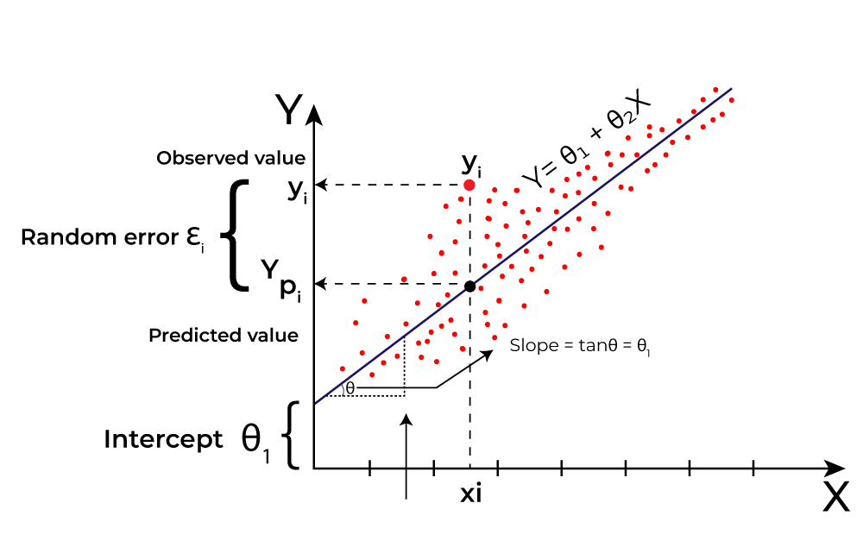
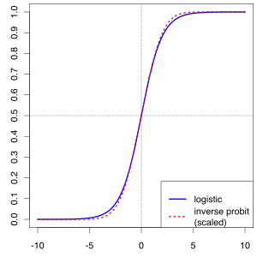
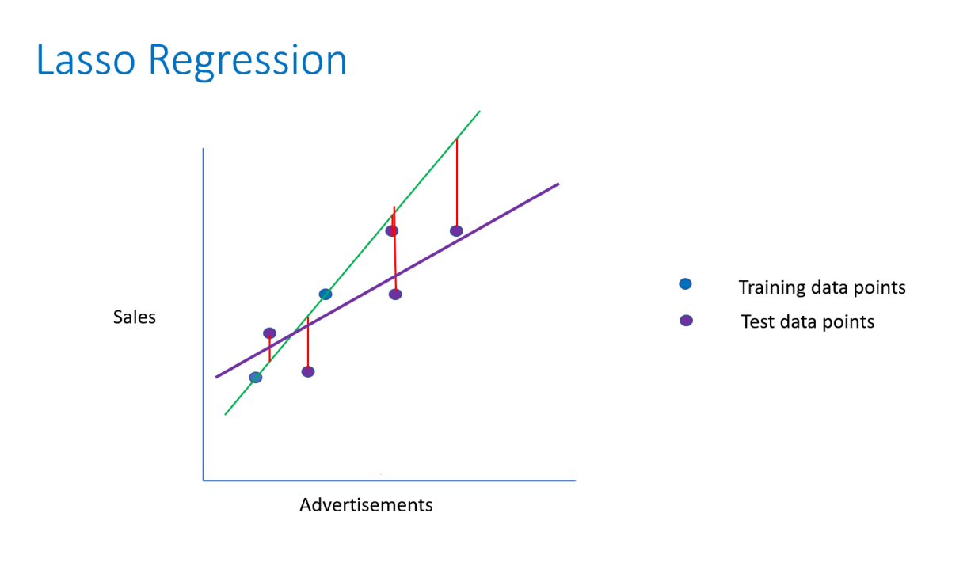
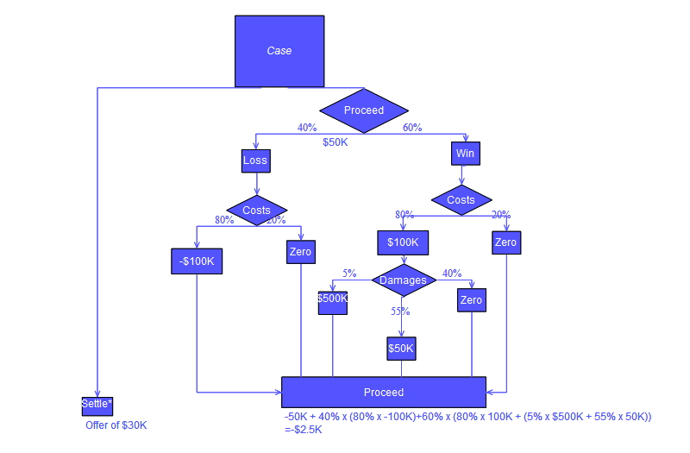
Algorithm Used:
Linear Regression
Linear Regression is a technique to estimate the linear relationship between each of a number of independent variables and a dependent variable. Linear Regression fits a linear model with coefficients w = (w1, …, wp) to minimize the residual sum of squares between the observed targets in the dataset, and the targets predicted by the linear approximation.
Lasso Regression
Lasso (Least Absolute Shrinkage and Selection Operator) regression performs L1 regularization meaning that it adds a factor of the sum of the absolute value of coefficients in the optimization objective. This penalizes large coefficients when optimizing the linear relationship of each variable, like Ridge Regression.
Decision Tree
A decision tree is a non-parametric supervised learning algorithm, which is utilized for both classification and regression tasks. It has a hierarchical, tree structure, which consists of a root node, branches, internal nodes and leaf nodes.

Slide 5
Overview :
In this project, I aimed to predict the car price in a automobile company from Japan dataset using machine learning techniques. I performed extensive data analysis, including exploratory data analysis (EDA) to understand the characteristics of the dataset, and then proceeded with data preprocessing, model building, and evaluation.
I built three classification models: Linear Regression, Lasso Regression, and Decision Tree and evaluated their performance using various techniques:
Normal: without any balancing technique
Over-sampling: using SMOTE (Synthetic Minority Over-sampling Technique.)
Under-sampling: using Random Under Sampler
I found that Linear Regression Model produced the best results, particularly for identifying Car Price. Among the models, Linear Regression consistently performed the best, offering a good balance of Hyperparameters for identifying Car Price.

Slide 6
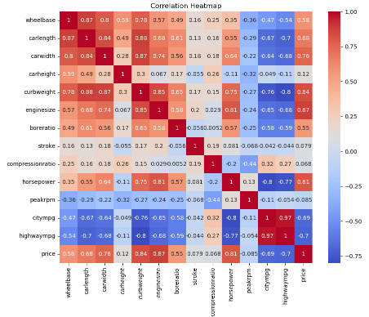
EDA (Exploratory Data Analysis) :
Data Cleaning
Univariate Analysis
Engine differs in bore ratio and stroke
Dropped Unnecessary columns – “CarId“
No nulls & No duplicates were found
Insights in Data Distribution
Bivariate Analysis
Explored the impact of categorical variables (['fueltype', 'aspiration', 'doornumber', 'carbody', 'drivewheel', 'enginelocation', 'enginetype', 'cylindernumber', 'fuelsystem', 'CarCompanyName']
Multivariate Analysis
Collinearity among variables was checked using a correlation heatmap, revealing no strong multicollinearity issues.
Risk ratings symboling vary from -2 to 3.
Features like carwidth, curbweight, enginesize show notable variability.
Potential outliers present in compressionratio and horsepower.

Slide 7
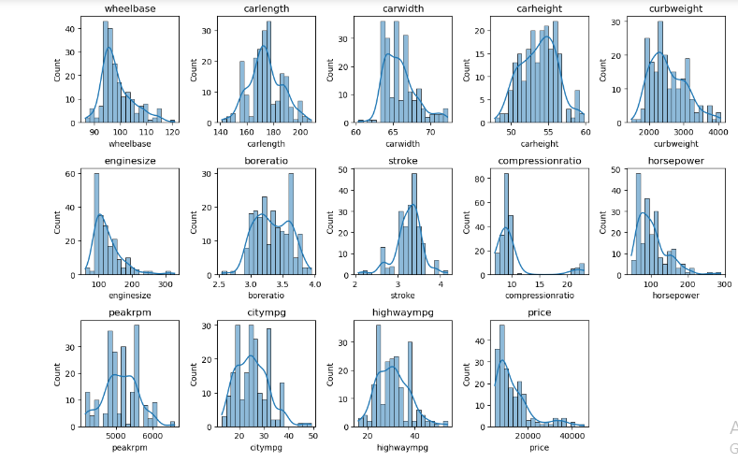
Key Findings of EDA :

Slide 8
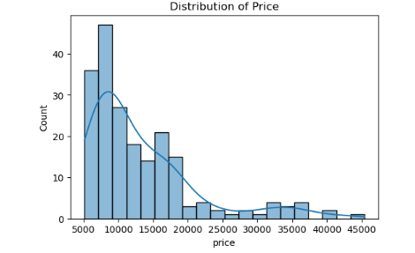
Price Distribution:
Insights found that the maximum Car Companies have the price of the car between $5K to $15K.

Slide 9
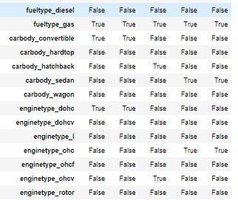
Data Preprocessing :
Converted Categorical Variables to One Hot Encoding:
Standard Scaling:
Performed standard scaling to normalize numerical features.
Ensures all variables are on a similar scale, preventing features with larger magnitudes from dominating the model.
'fuel type’, ’car body’, 'engine type' : Transformed into One Hot Encoding representation by replacing True or False
All values Categorical utilized one-hot encoding to represent categorical values as binary.

Slide 10
Model Building:
In model building , machine learning algorithms are trained on historical data to make predictions.
ML Algorithm that I have used is Linear Regression, Lasso Regression & Decision Tree.
Three techniques were employed for building and evaluating predictive models for Car Price prediction:
Linear Regression
Linear regression is a parametric regression algorithm that models the relationship between variables with a linear equation.
Lasso Regression
Decision Tree
Lasso regression is a regularization technique applied to linear regression to prevent overfitting and perform feature selection.
Decision Tree is a non-parametric algorithm that recursively splits the feature space to make predictions based on the values of the features.

Slide 11

Evaluation of Models :
Insights:
Linear Regression: Scores the best model in comparison of Lasso & Decision Tree.
Lasso Regression: Good Score in comparison of Decision Tree.
Decision Tree: Low Score in comparison of Linear Regression & Lasso Regression.

Slide 12
Further Improvement :
To further improve our model, we can explore additional feature engineering techniques, such as creating new features or incorporating external data sources.
We can also experiment with different model architectures and hyperparameter tuning techniques to optimize the model's performance.
Additionally, continuous monitoring and updating of the model with new data can help ensure its effectiveness over time.

Slide 13
Conclusion:
This project demonstrates the importance of predictive modeling in identifying and mitigating Car Price Prediction in the Automobile sector. By leveraging machine learning techniques, Car Company can enter in the US & European Market like in Japan Market.
And chosen model, Linear Regression, offers a balanced approach with Best model fitting score, making it a valuable tool for automobile sector to enter in the US & European Countries with there cars.

Slide 14
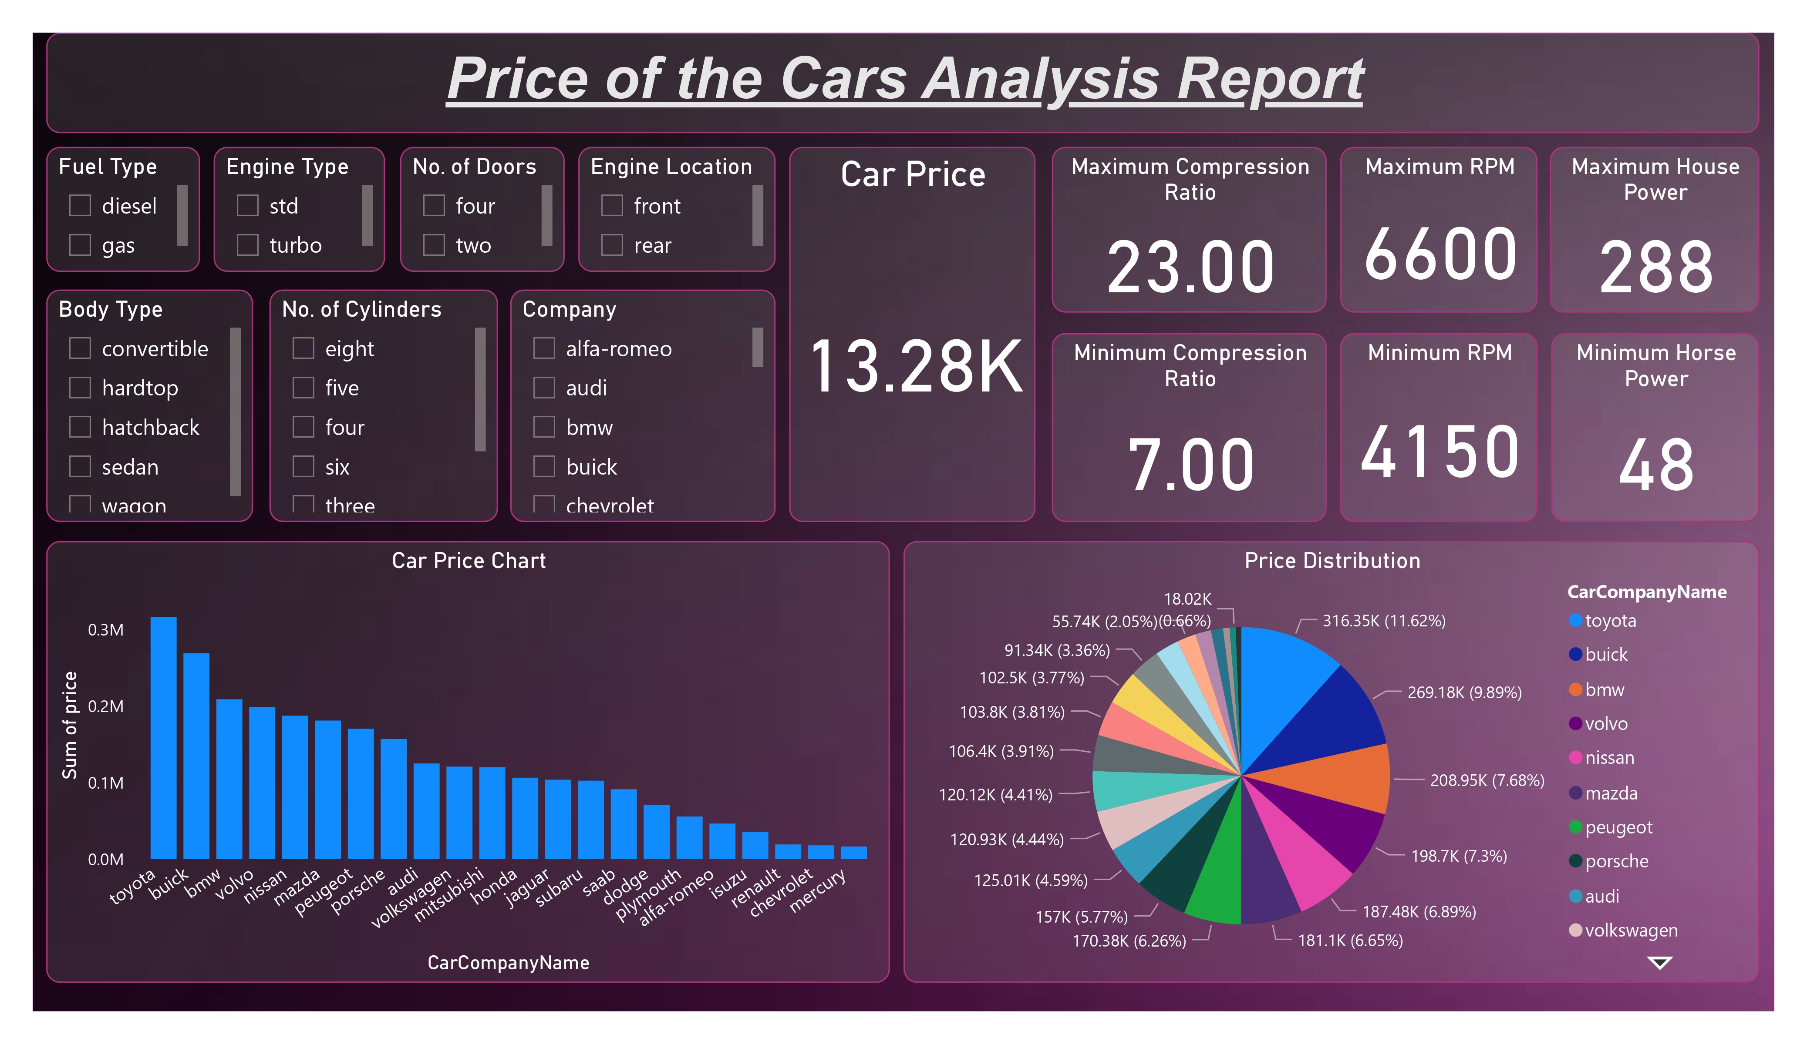
Power BI Dashboard

Slide 15
Thank You!

